Slide 1

7th Grade Accelerated Math
Unit 1, Lesson 3 Solving Two Step Equations Using Properties of Equality Volume 1, pg. 17

Slide 2


Benchmark
MA.7.AR.2.2
Write and solve two-step equations in one variable within a mathematical context or real-world context, where all terms are rational numbers.
volume 1, pg. 17

Slide 3
Integrated Mathematical Thinking and Reasoning Standards
MA.K12.MTR.1.1 Actively participate in effortful learning both individually and collectively.
MA.K12.MTR.4.1 Engage in discussions that reflect on the mathematical thinking of self and others.
MA.K12.MTR.5.1 Use patterns and structure to help understand and connect mathematical concepts.
volume 1, pg. 17

Slide 4

Learning Targets
I can relate properties of equality to solving two-step equations.
I can solve two-step equations in one variable.
volume 1, pg. 17

Slide 5

Warm-Up
volume 1, pg. 18

Slide 6
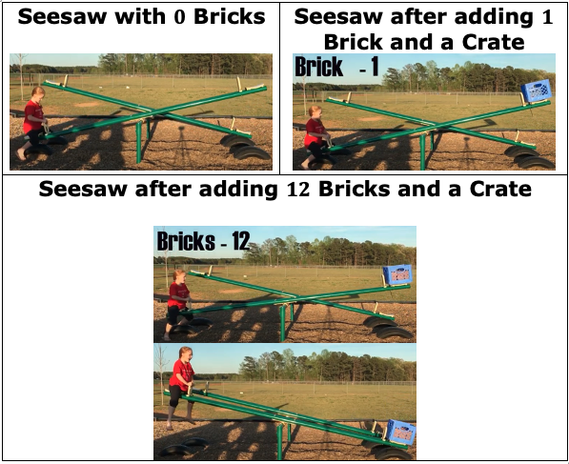
1.3.1 Warm-Up: Notice and Wonder
A math teacher and her daughter experimented with a seesaw at her local park. Their goal was to determine how the daughter could play on the seesaw on her own. She placed a crate on the other side of the seesaw and began adding bricks to it one at a time. Each time she added a brick, she tried to seesaw with the crate. A series of screenshots of her experiment are shown.
volume 1, pg. 18

Slide 7
1. Complete the table to indicate one thing you notice and one thing you wonder when looking at this situation.
2. Explain what is happening in this situation using the words “equal,” “greater than,” and/or “less than.”
One thing I notice is… | One thing I wonder is…
volume 1, pg. 18

Slide 8

Collaboration
volume 1, pg. 19

Slide 9

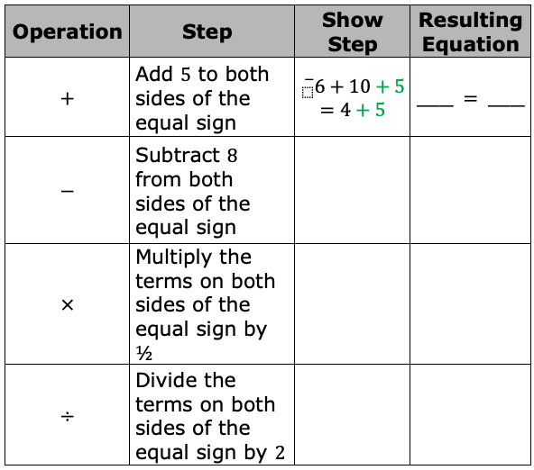
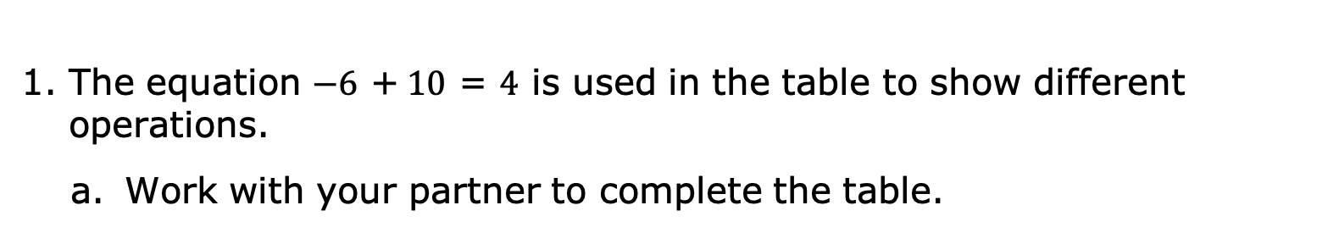
1.3.2 Exploration: Properties of Equality
The equation $−6$ +$10$ = $4$ is used in the table to show different operations.
Work with your partner to complete the table.
volume 1, pg. 19

Slide 10

b. What do you notice about each of the resulting equations?
c. With your partner, compare the results of multiplying each term in the original equation, ${}_{}^{−}6+10=4$, by $\frac{1}{2}$ and dividing each term by $2$. Summarize your observations.
volume 1, pg. 19

Slide 11
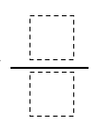
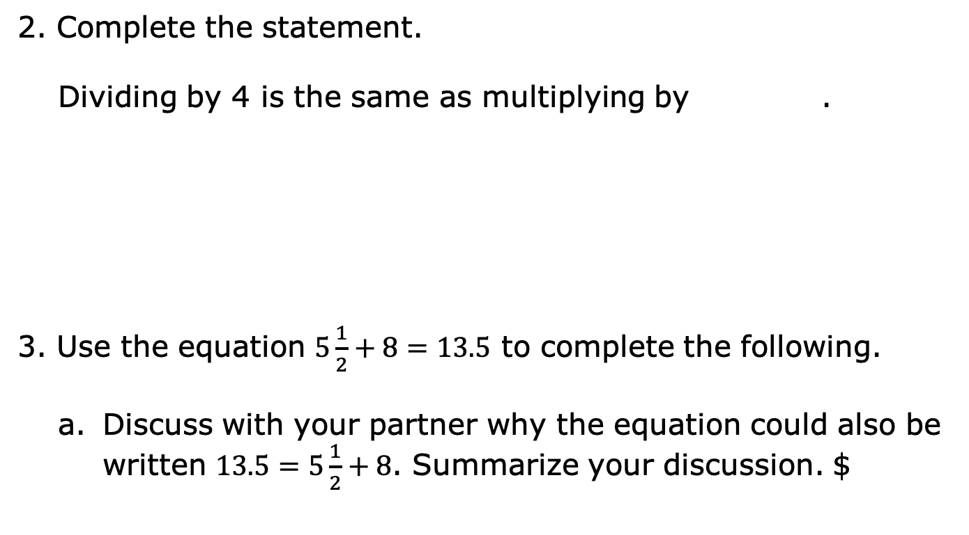
2. Complete the statement.
Dividing by 4 is the same as multiplying by .
3. Use the equation $5\frac{1}{2}+8=13.5$ to complete the following.
Discuss with your partner why the equation could also be written $13.5=5\frac{1}{2}+8$. Summarize your discussion. $
volume 1, pg. 19

Slide 12
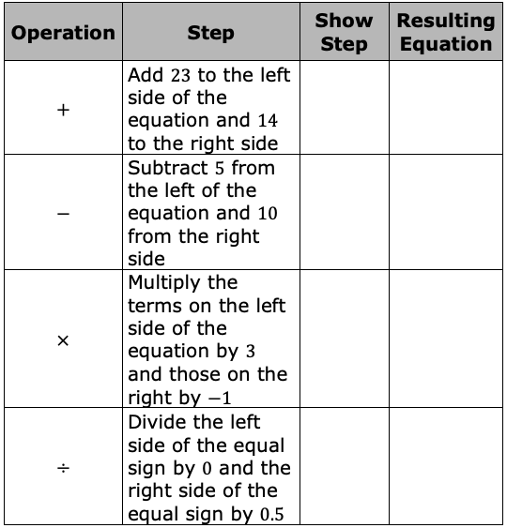
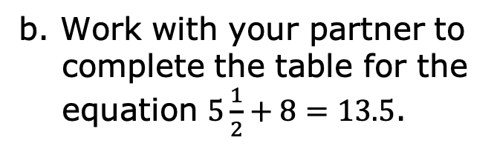
b. Work with your partner to complete the table for the equation $5\frac{1}{2}+8=13.5$.
volume 1, pg. 20

Slide 13
c. Prisha said it is not possible to complete the last row of the table. Explain why Prisha said it is not possible.
d. What do you notice about the resulting equations in the first three rows of the table?
volume 1, pg. 20

Slide 14



4. Complete the statements.
An equation compares two equivalent expressions using
the mathematical symbol = to show the values of both
quantities are When the same operation
is performed on both sides of an equation, the
quantities equivalent. When the
operations performed on both sides of an equation are
not the same, the resulting equation is
true because the quantities being compared are
equivalent.
volume 1, pg. 20

Slide 15

Bring It Together
volume 1, pg. 21

Slide 16

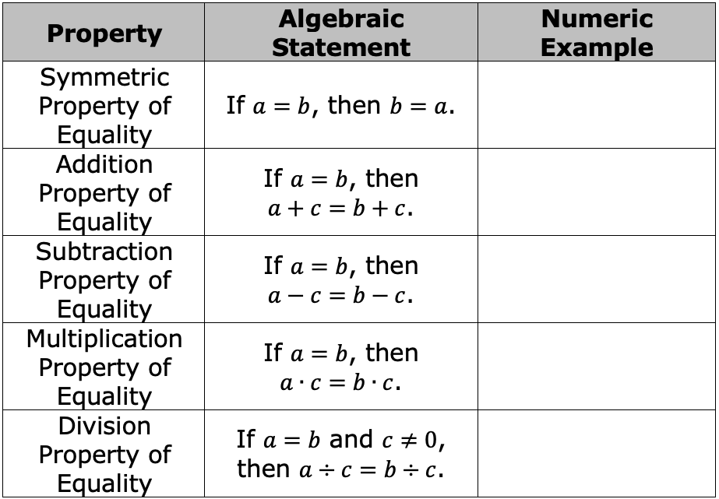
1.3.3 Bring It Together: Properties of Equality
Properties of equality can be used to solve equations.
1. Complete the table with a numeric example of each property of equality.
volume 1, pg. 21

Slide 17

2. Explain why $c≠0$ for the division property of equality.
3. Which property justifies the equation $2m−7.3=24.45$ is equivalent to $24.45=2m−7.3$?
volume 1, pg. 21

Slide 18

Guided Instruction
volume 1, pg. 21

Slide 19
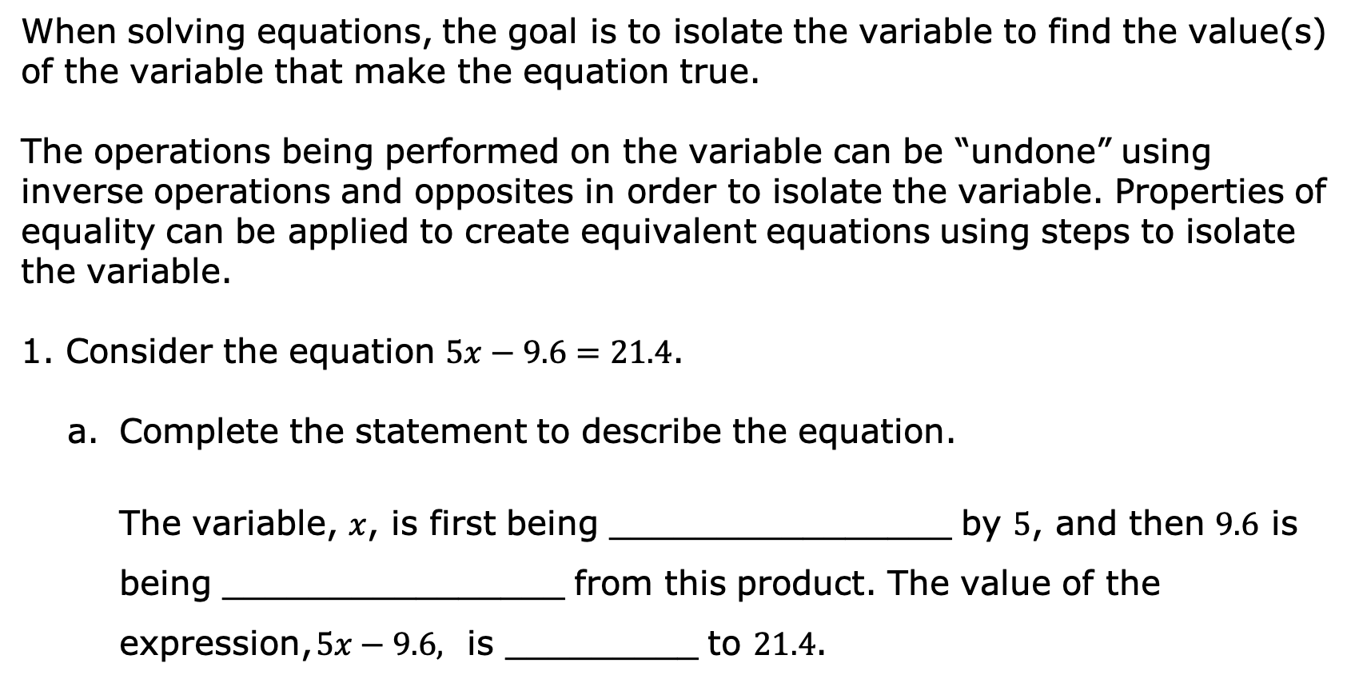
1.3.4 Guided Instruction: Solving Two-Step Equations Using Properties of Equality
When solving equations, the goal is to isolate the variable to find the value(s) of the variable that make the equation true.
The operations being performed on the variable can be “undone” using inverse operations and opposites in order to isolate the variable. Properties of equality can be applied to create equivalent equations using steps to isolate the variable.
Consider the equation $5x−9.6=21.4$.
Complete the statement to describe the equation.
The variable, $x$, is first being ________________ by $5$, and then $9.6$ is being ________________ from this product. The value of the expression, $5x−9.6,$ is _________ to $21.4$.
volume 1, pg. 21

Slide 20
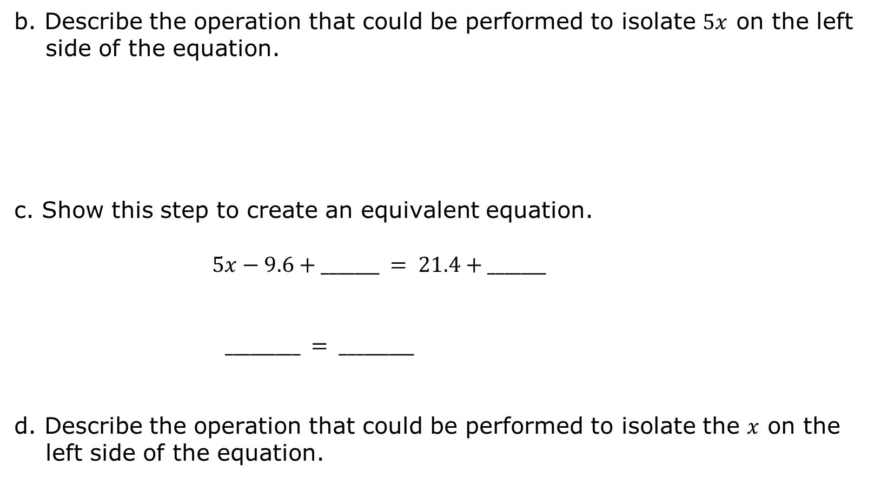
b. Describe the operation that could be performed to isolate $5x$ on the left side of the equation.
c. Show this step to create an equivalent equation.
$$5x−9.6+_______ = 21.4+_______$$
$_________ = _________$
d. Describe the operation that could be performed to isolate the $x$ on the left side of the equation.
volume 1, pg. 21

Slide 21
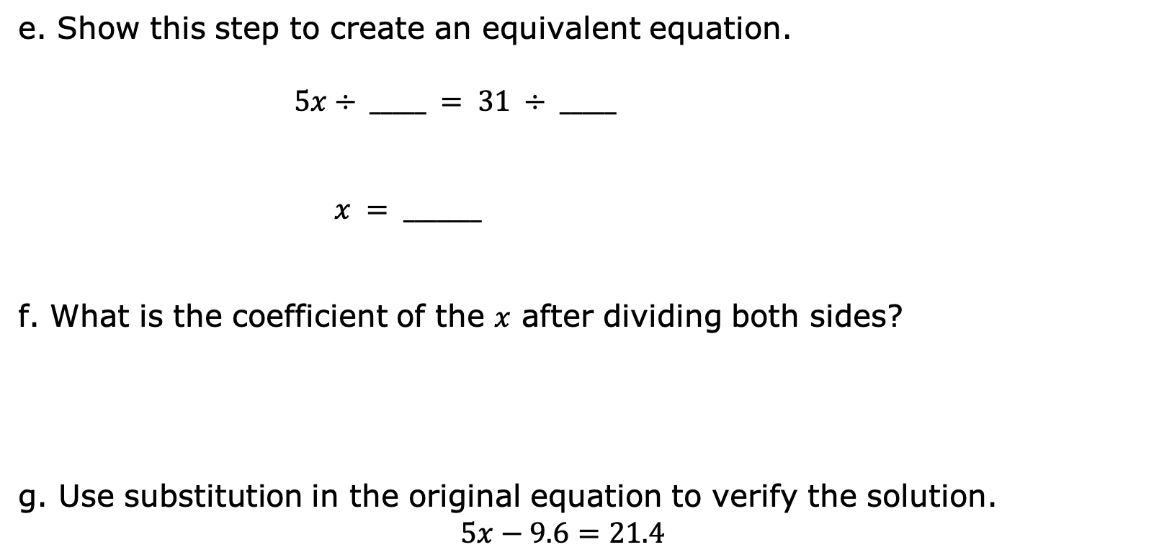
e. Show this step to create an equivalent equation.
$$5x÷ _____ = 31 ÷ _____$$
$x = _______$
f. What is the coefficient of the $x$ after dividing both sides?
g. Use substitution in the original equation to verify the solution.
$$5x−9.6=21.4$$
volume 1, pg. 22

Slide 22

h. Which properties of equality were applied to solve this equation?
i. Cameron said the equation $5x=31$ could have been solved by applying the multiplication property of equality. What value can be used as the factor that is multiplied to both sides of the equation to isolate $x$?
volume 1, pg. 22

Slide 23
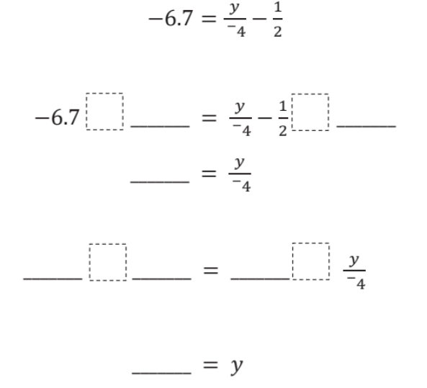
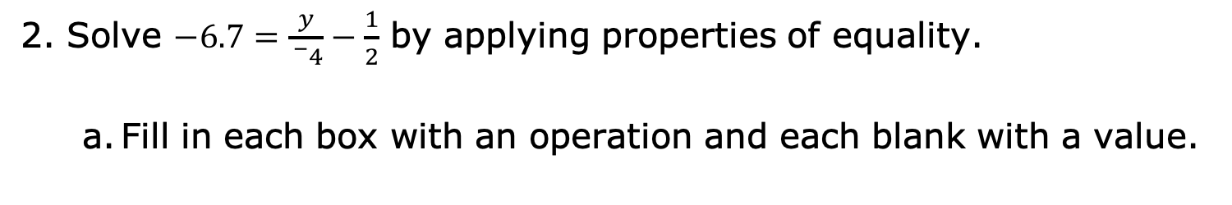
2. Solve $−6.7=\frac{y}{{}_{}^{−}4}−\frac{1}{2}$ by applying properties of equality.
Fill in each box with an operation and each blank with a value.
volume 1, pg. 23

Slide 24

b. Use substitution in the original equation to verify the solution.
$−6.7=\frac{y}{{}_{}^{−}4}−\frac{1}{2}$
c. Which properties of equality were applied to solve this equation?
volume 1, pg. 23

Slide 25

Try It
volume 1, pg. 23

Slide 26


1.3.5 Try It: Solving Two-Step Equations Using Properties of Equality
Work with your partner to complete the following.
Use the equation $4.76=−5+ 3.2n$ to complete the following.
a. Apply properties of equality to solve the equation.
b. Use substitution to verify the solution.
volume 1, pg. 23

Slide 27

2. Use the equation $\frac{5}{7}r+6\frac{3}{7}={}_{}^{−}8$ to complete the following.
a. Apply properties of equality to solve the equation.
b. Use substitution to verify the solution.
volume 1, pg. 23

Slide 28

Wrap-Up
volume 1, pg. 24

Slide 29
1.3.6 Wrap-Up: Cool Down
How can you use substitution to ensure your answer is correct?
When solving an equation, why do operations have to be performed on both sides of the equal sign?
volume 1, pg. 24

